Slide 1
Arrays
aka. Lists
18 March 2018

Slide 2
Welcome Back!
A quick warm-up: bird cage illusion
https://postimg.org/gallery/pvp2zm3o/

Slide 3
Previously in IMM120
Midterms!
How to Click Buttons
Select Midterm Gallery
See if you can spot what these projects have in common
Notes:
Show DND (Mark), IMM120 map (Sarah), album covers (Will with permission), THEN space map (Laura)

Slide 4
How To Click Buttons
Draw your button
Choose the right collision detector for your button
Use that collision detector in mousePressed
if collision occurs during click, action!

Slide 5
Previously in IMM120
Midterms!
How to Click Buttons
Select Midterm Gallery
See if you can spot what these projects have in common
Notes:
Show DND (Mark), IMM120 map (Sarah), album covers (Will with permission), THEN space map (Laura)

Slide 6
Handling Lots of Information
Arrays are used to store lots of information.
You can think of an array as a list of items.
This allows programmers to write easier to understand code that can easily be applied to many pieces of information.
Allows many objects or points of data to use the same code.
DRY – Don’t Repeat Yourself
WET – “write everything twice” or “we enjoy typing”

Slide 7
One Variable, One Value
variable x contains 10

Slide 8
One Variable, Many Values
variable x contains 10, 11, 2, and 7
Notes:
Explain how the rocket project works

Slide 9
Our First Array
brackets tell p5 we’re making an array
commas separate each value in the array
Notes:
Store all images in a single array

Slide 10
How Do We Access the Values?
0 1 2 3
index
The first index is 0, not 1

Slide 11
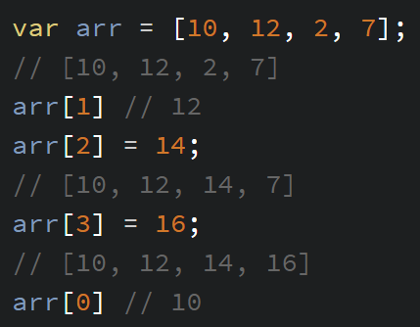
Use Each Index as an Individual Variable
READ
ASSIGN

Slide 12
Using All Items in an Array
0 1 2 3
for (var i in arr) { // i for index
// i: 0, 1, 2, 3
}

Slide 13
Looping
previous line
for (var i in arr)
{
// i: 0, 1, 2, 3
}
for
}
if i < arr.length
i += 1
next line

Slide 14
Setting Array Values with a Loop
// Do this in setup
var arr = new Array(10);
for (var i in arr)
{
arr[i] = 7;
}
MAKE AN EMPTY ARRAY (for 10 items)
LOOP THROUGH ALL ITEMS
ASSIGN WITH LOOP
Notes:
Convert loadImages to srcs

Slide 15
Length
The most useful pieces of information an array provides is its length:
arr.length == 10

Slide 16
Reminder About Modulo (%)
var i = frameCount % colors.length;
// i % 4: 0, 1, 2, 3, 0, 1, 2, 3, 0, 1, 2, 3…
fill(colors[i])

Slide 17
Using Arrays For Shapes
There’s no way to save a shape to a save-able value. ☹
For multiple shapes, we can save each number in a separate array.
ellipse(100, 200, 50);
var xArr = [ ];
var yArr = [ ];
var rArr = [ ];

Slide 18
Using Arrays For Shapes
There’s no way to save a shape to a save-able value. ☹
For multiple shapes, we can save each number into objects.
ellipse(100, 200, 50);
var circles = [
,…
{
x: ,
y: ,
r: ,
},…
];
Notes:
Convert bouncing planet to many planets

Slide 19
More Ways to Update Arrays
.unshift(value)
.push(value)
[ value, 1, 2, 3 ]
[ 1, 2, 3, value ]
[0, 1, 2]
x = .shift()
x = .pop()
[ 2, 3 ]
[ 1, 2 ]

Slide 20
[0, 1, 2].push(3)
[0, 1, 2, 3]
Notes:
The array in this case would be saved to a variable, this is an illustration.
Most common one.

Slide 21
var x = [0, 1, 2].pop()
x = 2 / [0, 1, 2]

Slide 22
var x = [0, 1, 2].shift()
x = 0 / [0, 1, 2]

Slide 23
[0, 1, 2].unshift(3)
[3, 0, 1, 2]

Slide 24
More Ways to Update Arrays
arr.unshift(value)
arr.push(value)
[ value, 1, 2, 3 ]
[ 1, 2, 3, value ]
[0, 1, 2]
x = arr.shift()
x = arr.pop()
[ 2, 3 ]
[ 1, 2 ]

Slide 25
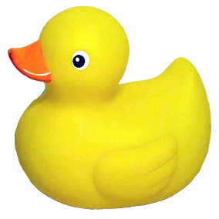
Your Turn: add a planet on click
http://alpha.editor.p5js.org/crhallberg/sketches

Slide 26
Minute Survey
Broken Printer Edition

